Slide 1


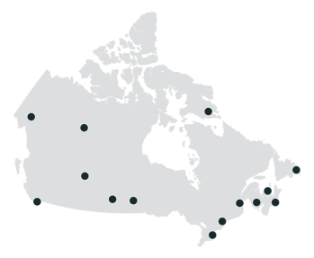
PRESS F5 on your keyboard to start animation

Slide 2

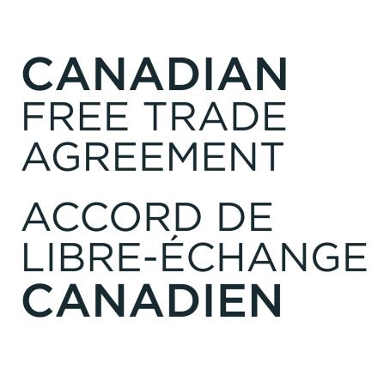

Slide 3

Technical Briefing
Updated: April 3, 2017
V.4.0

Slide 4

Overview
December 2014: A comprehensive renewal of the 1995 Agreement on Internal Trade (AIT) was launched with the aim of strengthening and modernizing the Agreement.
  Under the direction of Canada’s Premiers and the federal government, Ontario’s Minister responsible for Internal Trade, Minister Brad Duguid chaired the negotiations.
July 22, 2016: Premiers announced that an agreement in principle had been reached. Working with the federal government, Ministers responsible for Internal Trade were directed by Premiers to finalize the remaining technical issues surrounding the Canadian Free Trade Agreement (CFTA).
April 7, 2017: All federal, provincial, territorial governments formally announce the conclusion of the CFTA negotiations. The text of the agreement is publicly released.
July 1, 2017: The CFTA enters into force, replacing the AIT.

Slide 5
The CFTA - Architecture and Principles
The CFTA will replace the existing AIT, ushering in a more ambitious and comprehensive Agreement.
The CFTA will cover nearly every sector of the Canadian economy, whereas the AIT’s structure limited coverage to certain sectors or industries.
The CFTA will increase transparency by subjecting all government measures (e.g. laws, regulations, policies) to the Agreement’s rules, unless they fall under one of the Agreement’s general or party-specific exceptions.
The CFTA will better align domestic trade commitments with those in Canada’s international agreements, such as the Canada-EU Comprehensive and Economic Trade Agreement (CETA).
  At its core, the CFTA prohibits discriminating among goods, services, workers and investments based on their province or territory of origin.
  Canadian businesses will compete on an equal footing with the foreign nationals and businesses of Canada’s international trade partners within the domestic market.

Slide 6
Modernized Trade Rules under the CFTA
The CFTA introduces a comprehensive internal trade framework that will enhance trade within Canada.
Non-Discrimination: All goods, services, workers and investments from anywhere in Canada must be provided with the same non-discriminatory treatment across the country. This obligation applies equally to new goods and services as industries continue to evolve (for example, new technology emerging in the green energy sector).
Free Flow of Goods: Rules ensure that technical regulations do not create unnecessary obstacles to trade. Governments may also continue to adopt measures to protect food safety and human, animal and plant life or health, while preserving the highest health and safety standards for Canadians.
  Open Markets for Services: Canadian service providers, such as engineering and construction firms, will not face discriminatory licensing or residency requirements or other restrictions that would impact their ability to provide services across Canada (e.g. limits on the number of service suppliers that may operate in a province or territory).
  Government licensing and qualification requirements across Canada will be governed by rules ensuring transparency, timeliness, and impartiality.

Slide 7
Modernized Trade Rules under the CFTA
Investment Protections: Rules ensure that investors will not be barred or restricted from investing in another jurisdiction. This will enable investors to more freely seek economic opportunities across the country.
Monopolies and Government Enterprises: When monopolies and government enterprises are undertaking commercial activities in Canada, they must provide non-discriminatory treatment and act solely in accordance with commercial considerations in their purchase or sale of a good or service, or their treatment of investors.
Government Procurement: Rules ensure a level playing field for companies operating across Canada.
  Open procurement will be subject to dispute mechanisms that allow individual suppliers to challenge contested bids. These mechanisms will be in place for all federal, provincial and territorial governments.
  Governments will cooperate to implement a single electronic portal, which will make it easier for Canadian businesses, especially small and medium-sized companies, to find procurement opportunities across the country.

Slide 8
New Regulatory Provisions to Enhance Internal Trade
The CFTA contains new rules to eliminate regulatory barriers that impede internal trade, which include:
Regulatory Reconciliation: The Agreement will establish a process to reconcile regulations that act as a barrier to trade, investment or labour mobility within Canada.
Regulatory Notification: Governments will publish descriptions of any proposed regulatory measure that significantly impacts internal trade. Comments and feedback from other governments, businesses and the public will be taken into consideration.
Regulatory Cooperation: Governments will cooperate in the development of future regulations to facilitate innovation, competition and growth in emerging industries, technologies and sectors.

Slide 9
New Procurement Opportunities for Canadian Suppliers
The CFTA better aligns domestic procurement rules with those in Canada’s international trade agreements.
  Canadian businesses will be able to compete on an equal footing with foreign companies operating under Canada’s international trade agreements.
Parties have made ambitious commitments to expand open procurement practices that will help create a level playing field for companies operating across Canada.
  For the first time, the energy sector will be covered by open procurement rules, resulting in more than $4.7 billion per year in procurement being opened up to broader competition.
  Regulated professionals, such as engineers and architects, will be able to compete more easily for government contracts across the country.
9

Slide 10
Improved Dispute Resolution Provisions
The CFTA incorporates the AIT’s dispute settlement chapter with important enhancements that will ensure jurisdictions are actively living up to the Agreement’s rules.
  The maximum monetary penalties for governments that act in a manner inconsistent with the Agreement have been increased from the previous AIT – up to $10 million for the largest jurisdictions by population.
  Changes have been made to improve the administrative efficiency of person-to-government disputes, which will help to reduce associated costs.
  A new summary dismissal process has been added to ensure that a dispute brought by an enterprise or individual against a Party can proceed quicker.
10

Slide 11
Elements Retained from the Existing AIT
The CFTA retains a number of elements from the AIT that have functioned well:
Labour Mobility: The CFTA incorporates all AIT elements requiring that workers in hundreds of regulated occupations will continue to be able to work anywhere in Canada without having to undergo significant additional training or assessment.
Environment: Parties will continue to strengthen policies and practices in areas such as climate change. The CFTA commits Parties to uphold high levels of environmental protection when encouraging trade and investment in Canada.
Exceptions: The CFTA retains general exceptions, which preserve necessary flexibility to regulate in some critical areas of government responsibility, such as national security, culture, taxation, and for specific groups, such as Aboriginal peoples.

Slide 12
Enhancing Interprovincial Trade in the Future
The CFTA contains a forward-looking agenda of important initiatives to further strengthen Canada’s economic union. For example:
Alcohol: Within one year of the CFTA taking effect, a working group will report back to Ministers responsible for Internal Trade with recommendations to enhance trade in wine, beer and spirits within Canada.
Financial Services: Within six months, the Parties will engage in exploratory discussions to assess the incorporation of rules applicable to financial services into the Agreement.
Fisheries sector: The Parties will establish a working group on trade in fish and fish products to consider how to further enhance trade in this sector.
Territorial Food Sector: Within six to twelve months, there is a commitment to develop options to enhance economic development in the food sector in the Territories, given the challenges in the production and cost of healthy food for territorial residents.

Slide 13
Contact Information
For further assistance on the CFTA, please contact your federal, provincial or territorial Internal Trade Representative.
For contact information, please visit: http://www.ait-aci.ca/contact-us/internal-trade-representatives/
13

Slide 14
Annex – CFTA Structure
CFTA – Table of Contents
Preamble
PART I – GENERAL
Chapter 1: Initial Provisions
PART II – GENERAL RULES
Chapter 2: General Rules (apply to entire economy)
PART III – SPECIFIC RULES
Chapter 3: Special Provisions (Goods, Services, Investment, Monopolies and Government Enterprises, Incentives) Chapter 4: Regulatory Notification, Reconciliation and Cooperation Chapter 5: Government Procurement Chapter 6: Environmental Protection Chapter 7: Labour Mobility
PART IV - EXCEPTIONS
Chapter 8: General Exceptions Chapter 9: Party-Specific Exceptions
PART V – INSTITUTIONAL , ADMINISTRATIVE, AND FINAL PROVISIONS
Chapter 10: Dispute Resolution Chapter 11: Institutional Provisions Chapter 12: Final Provisions
PART VI - DEFINITIONS
Chapter 13: Definitions
PART VII – PARTY SCHEDULES
Annex I: Exceptions for Existing Measures Annex II: Exceptions for Future Measures
The CFTA employs a “negative-list” approach, covering nearly all sectors of the economy, which significantly expands on the scope of the AIT.
14

